Slide 1

Chapter 10
Power, Politics, and Social Order
Notes:
For a better classroom presentation flow, the order of some topics in this lecture outline differs slightly from the order of topics in the text and, where this occurs, some figures and tables are out of numerical order.

Slide 2
Learning Objectives
10.1 Recognize how anthropologists define and study public power.
10.2 Identify ways that cultures maintain social order and address conflict.
10.3 Illustrate changes in public power and social control.

Slide 3
Public Power: Political Organization and Leadership (1 of 3)
10.1 Recognize how anthropologists define and study public power.
The scope of political anthropology
  Who has power and who does not
  Degrees of power
  Bases of power
  Abuses of power
  Political organization and government
  Political leadership roles
  Relationships between political and religious power
  Changes in political organization and power relationships through globalization and media

Slide 4
Public Power: Political Organization and Leadership (2 of 3)
Three aspects of political leadership
  Power: the ability to bring about results, often through the possession or use of forceful means
  Authority: the right to take certain forms of action
  Influence: the ability to achieve a desired end by exerting social or moral pressure on someone or some group

Slide 5
Public Power: Political Organization and Leadership (3 of 3)
Types of political organization
  Bands
  Tribes
  Chiefdoms
  States

Slide 6
Bands (1 of 2)
Foraging groups
Between 20 and a few hundred people; everyone knows one another and are kin
Membership is flexible
Leader is “first among equals”
Leader has influence, perhaps authority, but no power

Slide 7
Bands (2 of 2)
Do bands have “politics”?
  Not in a formal sense
    Leadership roles are not formalized
    No marks of political membership exist
  But bands can and do make decisions as a group
    When to migrate
    How to deal with internal and external threats

Slide 8
Tribes (1 of 3)
Associated with horticulture and pastoralism
Comprise several bands with similar lifestyle, language, and territory
Members know each other and are related
Leadership combines both achieved and ascribed status
Leader (“headman”) resolves conflict
Leader relies on influence and authority, sometimes power

Slide 9
Tribes (2 of 3)
Big-Man/Big-Woman Leadership
  Category of political organization midway between tribes and chiefdoms
  Personality, favor-based political groupings
  Heavy responsibilities in regulating internal and external affairs
  Leadership is mainly achieved
  Common in Melanesia, the South Pacific

Slide 10
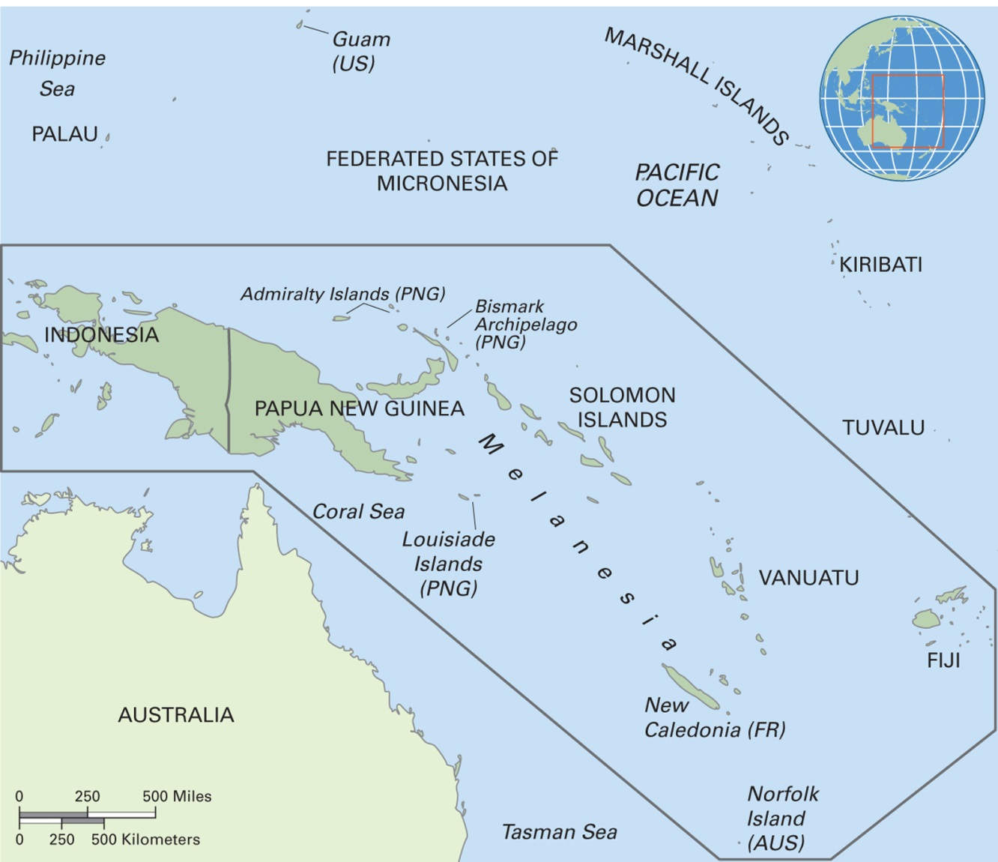
Map 10.2 Melanesia
Notes:
Melanesia is a region in the South Pacific that includes the independent states of Papua New Guinea, the Republic of Vanuatu, the Solomon Islands, and Fiji as well as many islands that are controlled by other countries. It also encompasses the western part of the island of New Guinea, which is controlled by Indonesia, and islands to the west of it, though the people there do not identify themselves as Melanesians.

Slide 11
Tribes (3 of 3)
Big-Man/Big Woman Leadership
  Making moka
    Moka is the term for large public feasts, with political motives, in highland Papua New Guinea
    They are a key part of big-man politics throughout Melanesia
    Leaders plan for years, sometimes, about how many pigs and other valuables they will give away at the moka
    Mokas depend on followers’ support and reinforce and build a leader’s status

Slide 12
Chiefdoms
Permanently allied tribes and villages under one leader
More centralized and socially complex
Heritable systems of social rank and economic stratification
Chiefship is an “office” that must be filled at all times
Achievement is measured in terms of personal leadership skills, charisma, and accumulated wealth
Confederacies are formed when chiefdoms are joined

Slide 13
States (1 of 4)
Centralized political unit encompassing many communities
Bureaucratic structure
Leaders possess coercive power

Slide 14
States (2 of 4)
State Powers and Roles
  Engage in international relations
  Monopolize the use of force and maintain law and order
  Maintain standing armies
  Define citizenship, rights, and responsibilities
  Keep track of citizens (census)
  Taxation, in-kind or cash
  Control and manipulate information
  Provide social services

Slide 15
States (3 of 4)
Symbols of State Power
  May connect leaders to deities
  Leaders may have special dress, housing, food, modes of transportation, etc. that distinguish them from the general populace (compare with the complete lack of such symbols in bands)

Slide 16
States (4 of 4)
Gender and Leadership in States
  Most contemporary states are hierarchical and patriarchal, to different degrees
  Highest rates of women’s political participation in the Nordic states
  Women’s political roles often indirect or tied to kinship

Slide 17
Social Order and Social Conflict
10.2 Identify ways that cultures maintain social order and address conflict.
Social control is the process by which people maintain orderly life in groups
Culturally defined rules and ways to ensure that people follow the rules
All cultures have some form of social control; vary in formality

Slide 18
Norms and Laws
Social norm: a generally agreed-upon standard for how people should behave, usually unwritten and learned unconsciously
Law: a binding rule created through enactment or custom that defines right and reasonable behavior and is enforceable by the threat of punishment

Slide 19
Systems of Social Control (1 of 12)
Systems of social control vary depending on social scale
  In small-scale, face-to-face groups, social control is less formal and more likely to be based only on norms
  In large-scale societies, norms regulate daily life but so do laws; punishment for violation of laws can be serious, including death

Slide 20
Systems of Social Control (2 of 12)
Social Control in Small-Scale Societies
  Disputes handled at the interpersonal level
  Groups may punish an individual with shaming, ridicule, or ostracism
  Emphasis on restoring order rather than punishment

Slide 21
Systems of Social Control (3 of 12)
Social Control in States
  Increased specialization of roles involved in social control
  Formal trials and courts
  Power-enforced forms of punishment, such as prisons and the death penalty
  Require specialized roles, including:
    Police
    Lawyers
    Judges

Slide 22
Systems of Social Control (4 of 12)
Policing
  A form of social control that includes surveillance and the threat of punishment
  Police discover, report, and investigate crimes
  They are associated with states
  Example: policing and crime rates in Japan

Slide 23
Systems of Social Control (5 of 12)
Trials and Courts
  Trial by ordeal: a way of judging guilt or innocence by putting the accused person through a test that is often painful
  Court system used in many contemporary societies
    Goal is to ensure justice and fairness
    Biases (such as racial, ethnic, gender) affect the achievement of the goal

Slide 24
Systems of Social Control (6 of 12)
Prisons and the Death Penalty
  The prison, as a place where people are forcibly detained as a form of punishment, has a long history
  The United States imprisons more people than any other country in the world
  Executions communicate a political message to the general populace about the state’s power and strength

Slide 25
Systems of Social Control (7 of 12)
Social Inequality and the Law
  Critical legal anthropologists examine the role of law in maintaining power relationships through discrimination
  Concern with social justice: concept of fairness based on social equality that seeks to ensure entitlements and opportunities for disadvantaged members of society

Slide 26
Systems of Social Control (8 of 12)
Case study: racial/ethnic discrimination in Australia
  Comparison of treatment of youth who are White and youth who are indigenous Australian
  Tracking what happened to youth in each category following “apprehension”
  At each step of the way, indigenous youth experienced a harsher process that took them to a less favorable outcome

Slide 27
Systems of Social Control (9 of 12)
All societies experience conflict with other groups and societies, though to different degrees
Varieties of conflict include:
  Ethnic conflict
    Sectarian conflict
  War
    Global-local conflict

Slide 28
Systems of Social Control (10 of 12)
Ethnic Conflict
  Ethnic identities commit people to a cause
  Deeper issues often exist, such as claims to material resources
    Water
    Oil, gas
  Sectarian conflict
    Conflict based on perceived differences between divisions or sects within a religion
    Often tied to/overlapping with ethnic conflict

Slide 29
Systems of Social Control (11 of 12)
War
  Organized group action directed against another group and involving lethal force
  Cultural variation in warlike conflicts, from those involving mainly symbolic conflict to those in which mass death is the goal

Slide 30
Systems of Social Control (12 of 12)
Global-Local Conflicts
  Between non-parallel entities
  Colonial
    Many examples of powerful states engaged in conflict with local populations of other countries to secure resources
  Corporate
    Multinational businesses in conflict with local communities
    A result has been attention to corporate social responsibility to reduce such conflicts

Slide 31
Think Like an Anthropologist:
Yanomami, the “Fierce People”? (1 of 4)
Horticultural people of the Amazonian rainforest
Studied since the 1960s by Napoleon Chagnon, who describes in writings and films a culture with high levels of violence related to:
  The waiteri complex, a set of attitudes and behaviors that stresses aggression
  The need to raid other villages to obtain wives (a biological, Darwinian explanation)

Slide 32
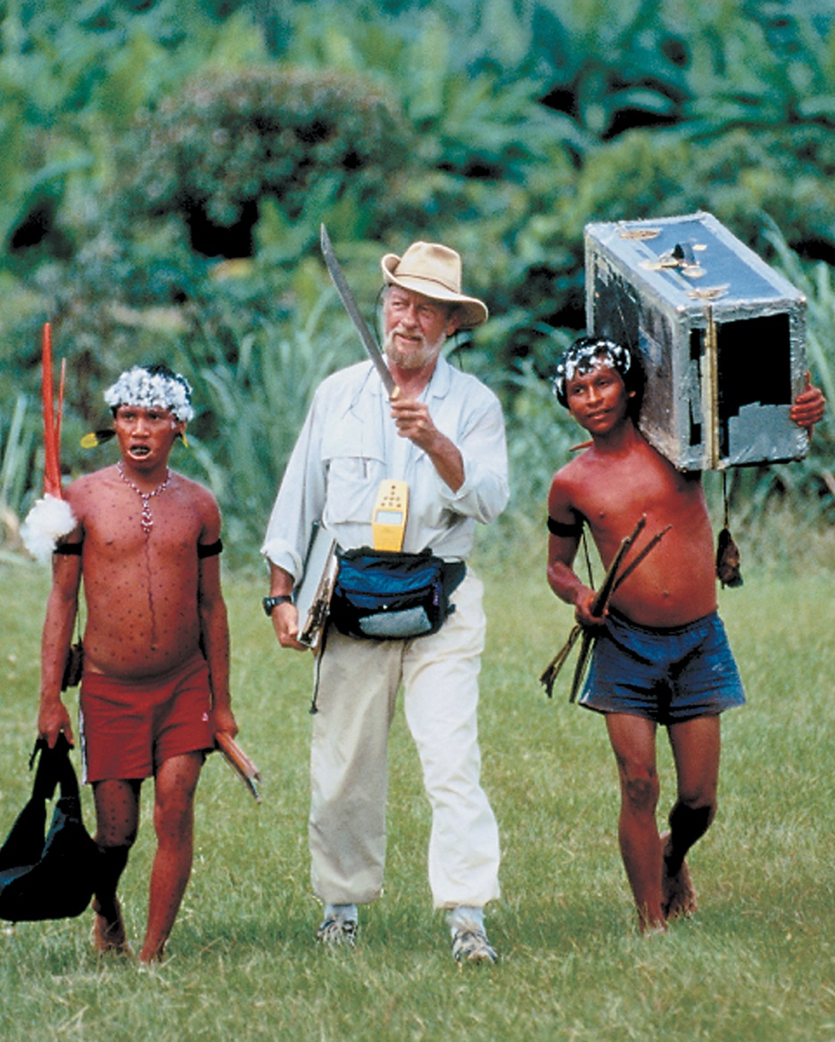
Think Like an Anthropologist:
Yanomami, the “Fierce People”? (2 of 4)
Notes:
Napoleon Chagnon in the field with two Yanomami men, 1995. Chagnon distributed goods such as steel axes and tobacco to the Yanomami to gain their cooperation in his research.

Slide 33
Think Like an Anthropologist:
Yanomami, the “Fierce People”? (3 of 4)
Two other explanations for Yanomami violence and warfare:
  Cultural materialist perspective: protein scarcity and population dynamics are the underlying cause of Yanomami warfare
  Historical view: intensified Western presence during the preceding 100 years caused the high levels of violence

Slide 34
Think Like an Anthropologist:
Yanomami, the “Fierce People”? (4 of 4)
Ethical questions raised by a journalist, Patrick Tierney:
  Chagnon and other U.S. researchers may have contributed indirectly to the high levels of violence by their presence, by giving many trade goods, by asking people to stage violence for their films
  A task force of the American Anthropological Association dismissed charges that Chagnon triggered or staged the violence

Slide 35
Changing Public Power and Social Control
10.3 Illustrate changes in public power and social control.
Nations and Transnational Nations
Democratization
The United Nations and International Peacekeeping

Slide 36
Nations and Transnational Nations
What is a “nation”? Different definitions exist:
  A group of people who share a language, culture, territorial base, political organization, and history
    U.S. would not be considered a nation under this definition
Nations and other groups constitute a political threat to state stability and control: Kurds, Maya, Tamils, Tibetans
Transnational nations: contemporary migration may cause a culture to be associated with multiple states
  Example: Puerto Rico

Slide 37
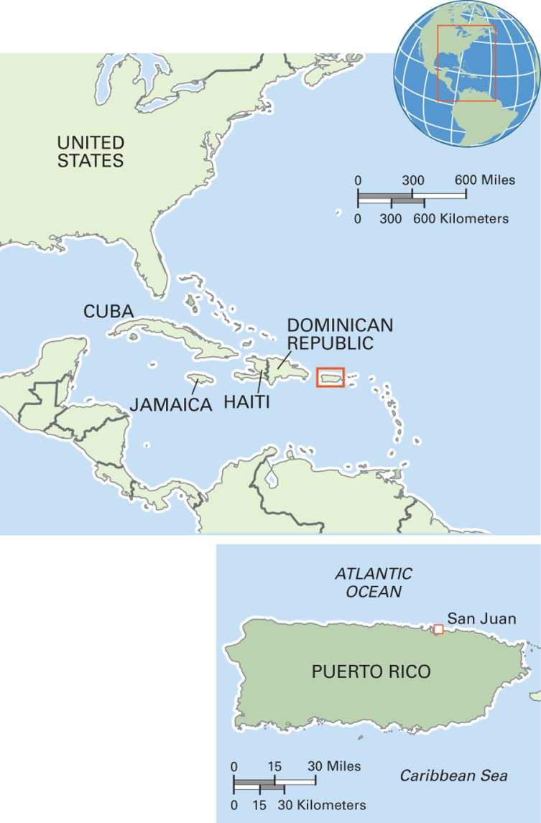
Map 10.6 Puerto Rico
Notes:
The Commonwealth of Puerto Rico is a U.S. territory with commonwealth status. The indigenous population of the island, the Tainos, is extinct. Analysis of DNA of current inhabitants of Puerto Rico reveals a mixed ancestry, including the Taino, Spanish colonialists, and Africans who came to the island as slaves. The economy is based on agriculture, and sugarcane is the main crop. Tourism is also important, as are remittances. Official languages are Spanish and English. Roman Catholicism is the dominant religion, although Protestantism is increasing.

Slide 38
Anthropology Works: Advocacy Anthropology and Community Activism in Papua New Guinea
Cultural anthropology knowledge put to use for indigenous peoples
Yonggom environment and livelihood damaged by large mining project in Ok Tedi, PNG
New roles of anthropologists as collaborators with the people studied and advocates on their behalf with outside institutions

Slide 39
Democratization
Process of transformation from an authoritarian regime to a democratic regime
  End of torture
  Liberation of political prisoners
  Lifting of censorship
  Toleration of some opposition
This transition is most difficult when the change is from highly authoritarian socialist regimes

Slide 40
Culturama: Kurds of the Middle East
Ethnic group of 20 to 30 million people
Most speak a dialect of Kurdish
Majority are Sunni Muslim
Strongly patrilineal
Home region, Kurdistan, extends from Turkey into Iran, Iraq, and Syria
Before WWI many Kurds were full-time pastoralists, herding sheep and goats
After WWI and the creation of new countries (Iraq, Syria, and Kuwait) Kurdish herders were unable to follow traditional grazing because of the new borders

Slide 41
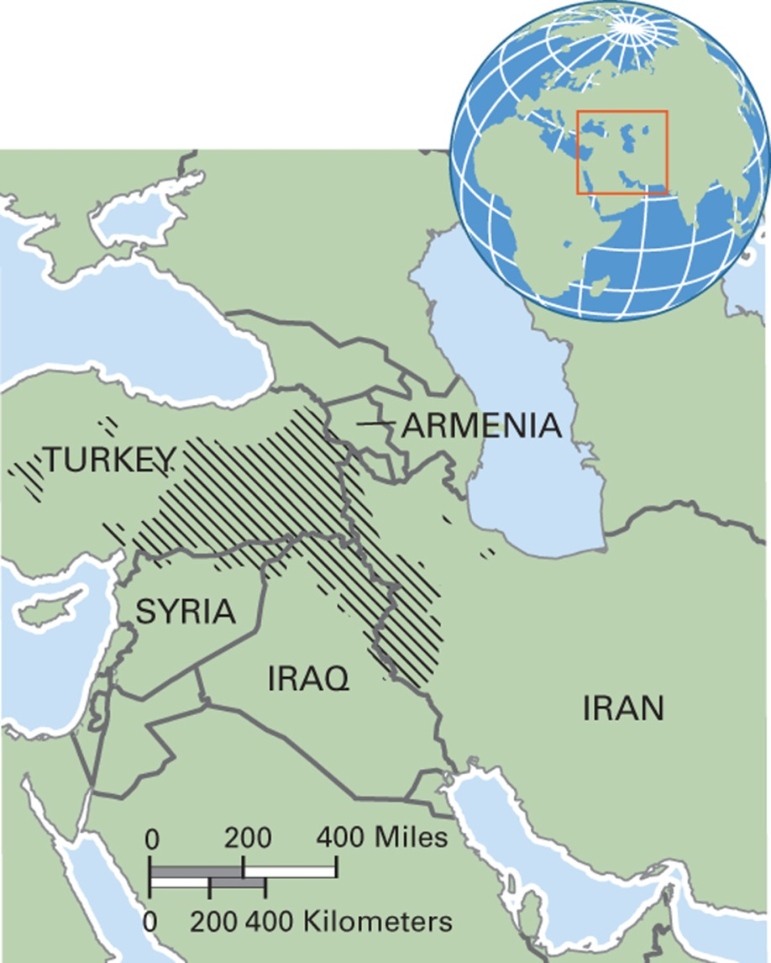
Map 10.5 Kurdish Region in the Middle East
Notes:
Kurdistan includes parts of Iran, Iraq, Syria, Turkey, and Armenia. About half of all Kurds live in Turkey.

Slide 42
The United Nations and International Peacekeeping
UN provides a forum for dispute resolution
Other NGOs and grassroots organizations may facilitate peacekeeping with initiatives that bridge group interests
Pessimistic view (Robert Carneiro)
  Warfare has no logical end within the world system of states

